Slide 1

Bioinformatics Methods in High-Throughput Sequencing of Rare Disease
Eric Levy
September 20, 2013
Division of Biomedical Informatics
Advisor: Lucila Ohno-Machado

Slide 2
Bioinformatics Tasks
“Bioinformatics is an interdisciplinary field that develops and improves on methods for storing, retrieving, organizing and analyzing biological data.” – Wikipedia
Anatomy of a bioinformatics task:
Parse/Preprocess
Obtain reference
Run statistics or model
Get results
Obtain data

Slide 3
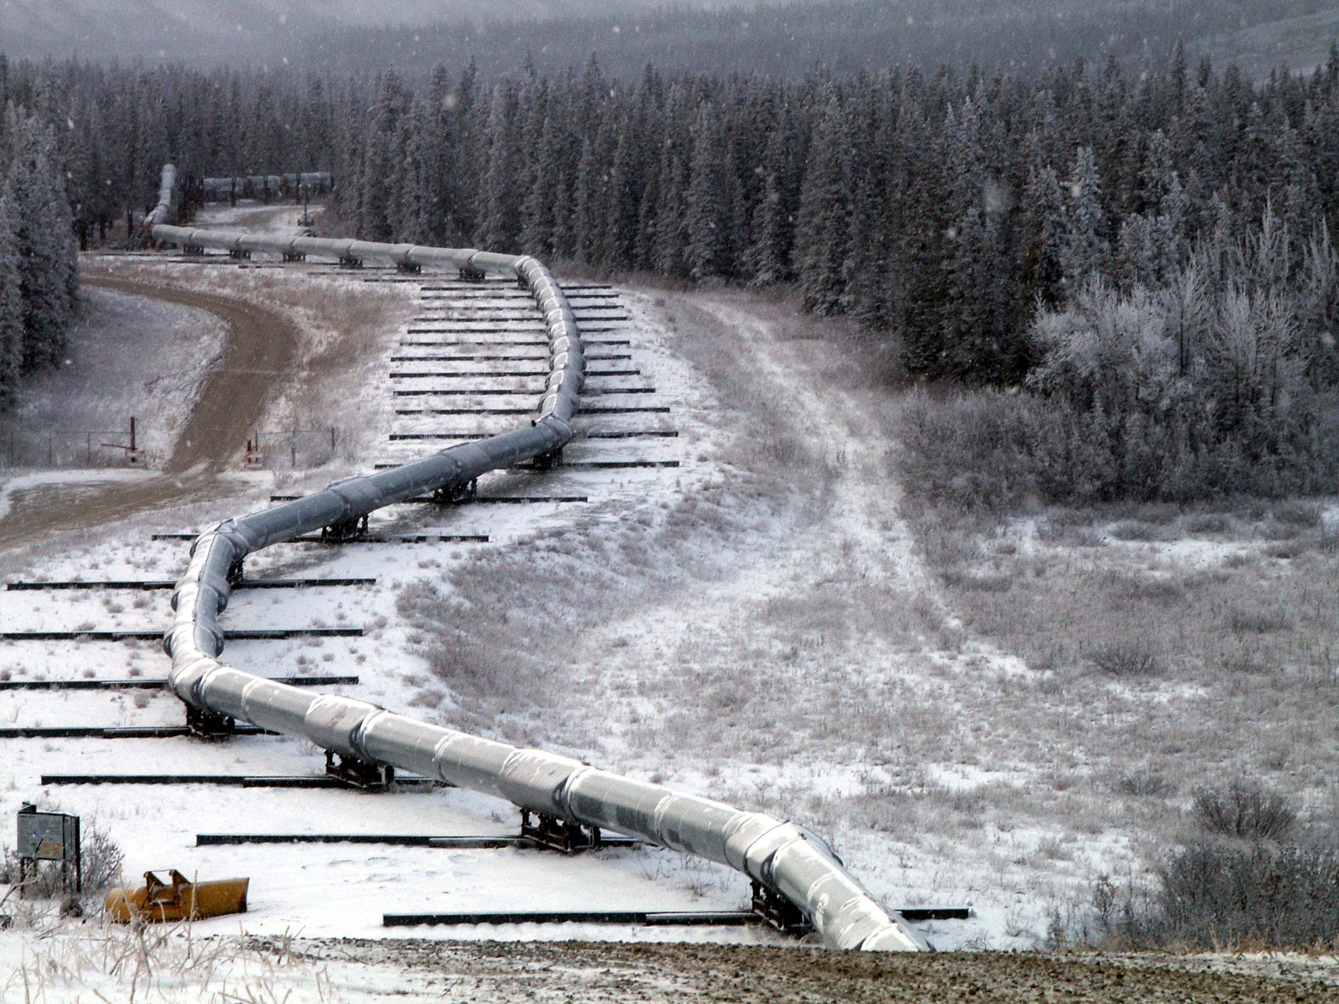
Introduction to Pipeline Building
Notes:
Goal: end-to-end analysis of data of interest
Problem: usually requires skills and time from a group of people to put together

Slide 4
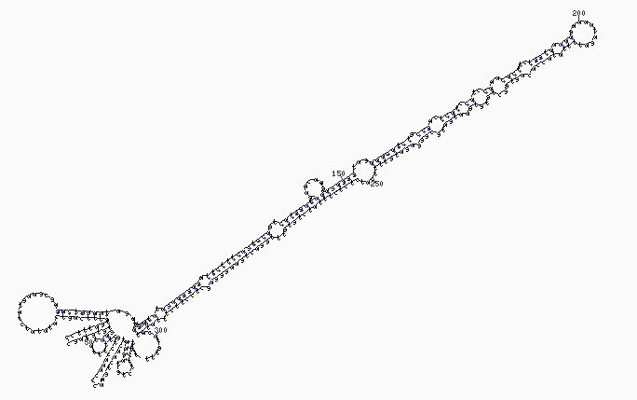
Application 1 - miRNA
Notes:
4 main components of presenting your new tool/pipeline

Slide 5
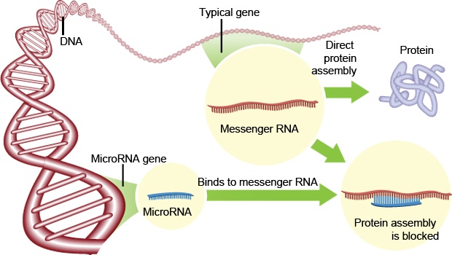
Background – miRNA Biology
MicroRNAs are short, single-stranded, non-coding RNAs that regulate gene expression
Notes:
1.) Interesting biological problem

Slide 6
Background – miRNA Analysis
Notes:
2.) Overview of existing tools

Slide 7
Background – Pathway Enrichment
Notes:
2.) and why they aren’t adequate

Slide 8
MAGI Pipeline
MicroRNA-seq Analysis in GPU Infrastructure
Goals:
All-inclusive analysis pipeline
Server with publically-accessible interface
Multiple sample analyses
Quality check information
GPU speedup
Features previously unavailable or to be improved:
Handling multiple large data files
Two-group statistical comparison
Novel miRNA from multiple samples
Improved execution time
Interactive visualization
Notes:
3.) Overview of your tool
4.) Demonstration of its improvements

Slide 9
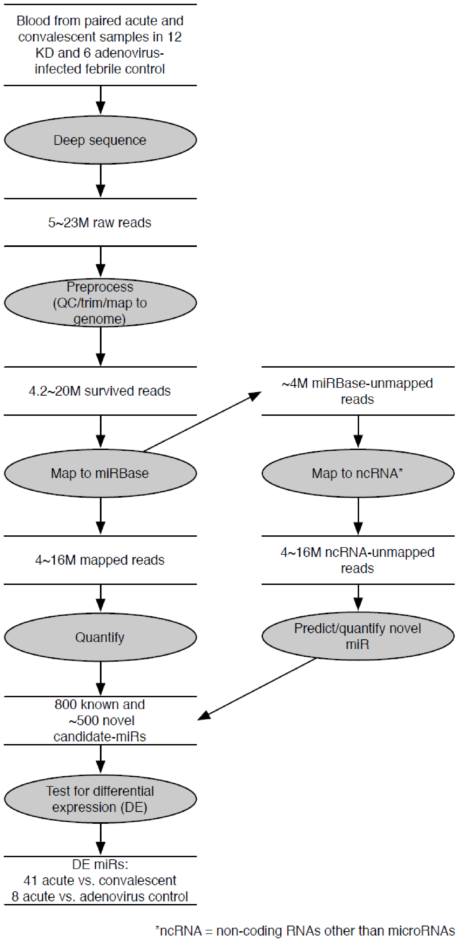
MAGI Pipeline
Main pipeline components
Mapping
Novel miRNA prediction
Target Prediction
Differential Expression
Pathway enrichment
Web visualization of results
Notes:
Show each major component of our pipeline, what skills were needed to implement it, and basic method that we completed it.

Slide 10

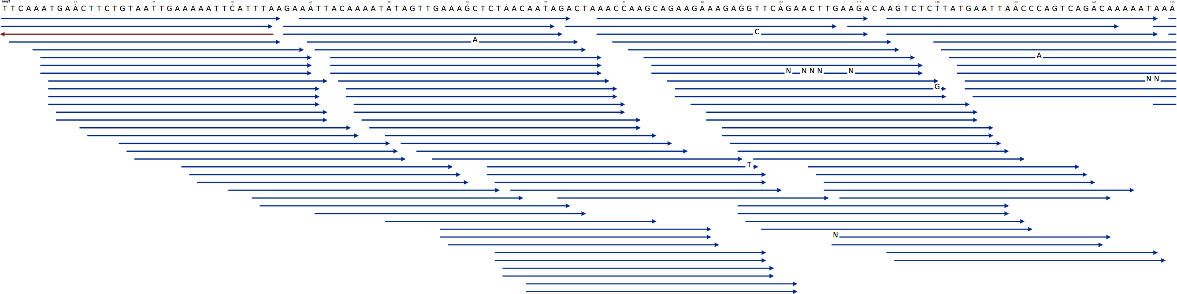
Mapping
Skills:
Command line tool usage/data flow
Proper reference sequences
Our application:
Bowtie 2
Identify known sequences
mRNA
Known miRNA
Other ncRNA
Filter potential novel miRNA sequences
Notes:
What tool you are using, what you are aligning to, parameters you are using, what you do with the mapped and unmapped reads/
Us: want to find known miRNAs, so align to miRNA reference. Want to detect novel miR, align to every gene/reference annotation we can find, and then leftovers can be sent to novel prediction.

Slide 11
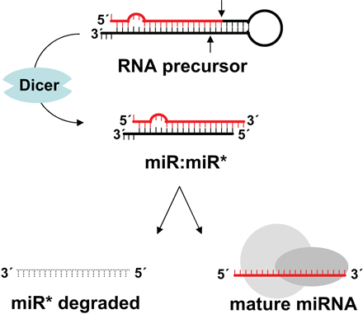
Novel miRNA Prediction
Skills:
Feature selection
Classifier building (machine learning)
Our application:
Similar to miRDeep 2
Notes:
Started with miRDeep 2, did a lot to further algorithm
Learning algorithm using features of sequences, energetic stability of hairpin structure, etc…
Assign probabilities to potential novel miR, figure out most likely ones to follow up with biological validation

Slide 12
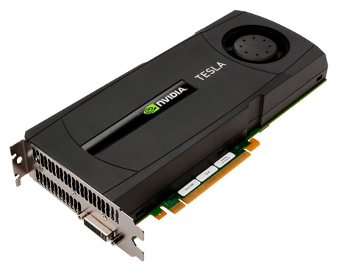
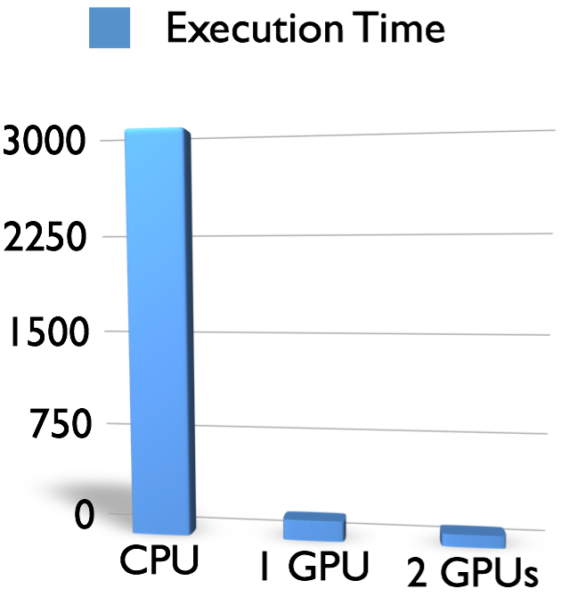
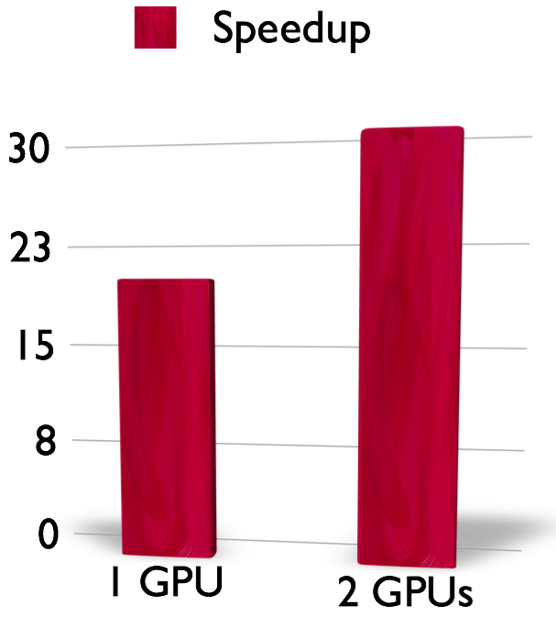
Target Prediction
Skills:
GPU computing (CUDA)
Our application:
CUDA-miRanda
Notes:
Predict sites in genes that are targeted by miRNAs through recognition/seed pairing sequence and some contextual features of miRNA and target site

Slide 13

Differential Expression
Skills:
R/statistics
Our application:
DESeq R package
Find differentially expressed miRNAs between acute and convalescent patients
Both known and novel

Slide 14
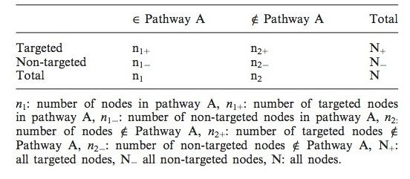
Pathway Enrichment
Skills:
Scripting
Reference databases
Out application:
Lists of differentially expressed known and novel miRNAs
Lists of genes targeted by these miRNAs
Known miRNA targets: microRNA.org predicted
Novel miRNA targets: miRanda MAGI output
KEGG pathways
Notes:
Using database systems

Slide 15






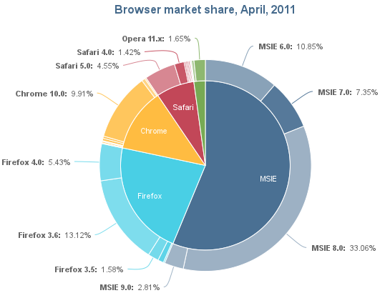
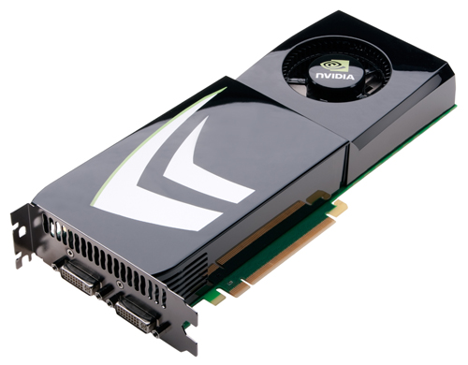

Server Management
Client
Server
web browser
2
analyze
1
upload
raw data
SQLite
GPU
3
Open a URL to a discovery report
Analytics
engine
Notes:
Pipeline in Perl.

Slide 16
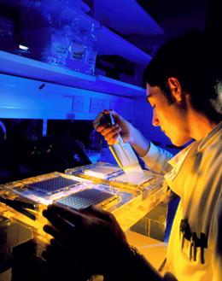
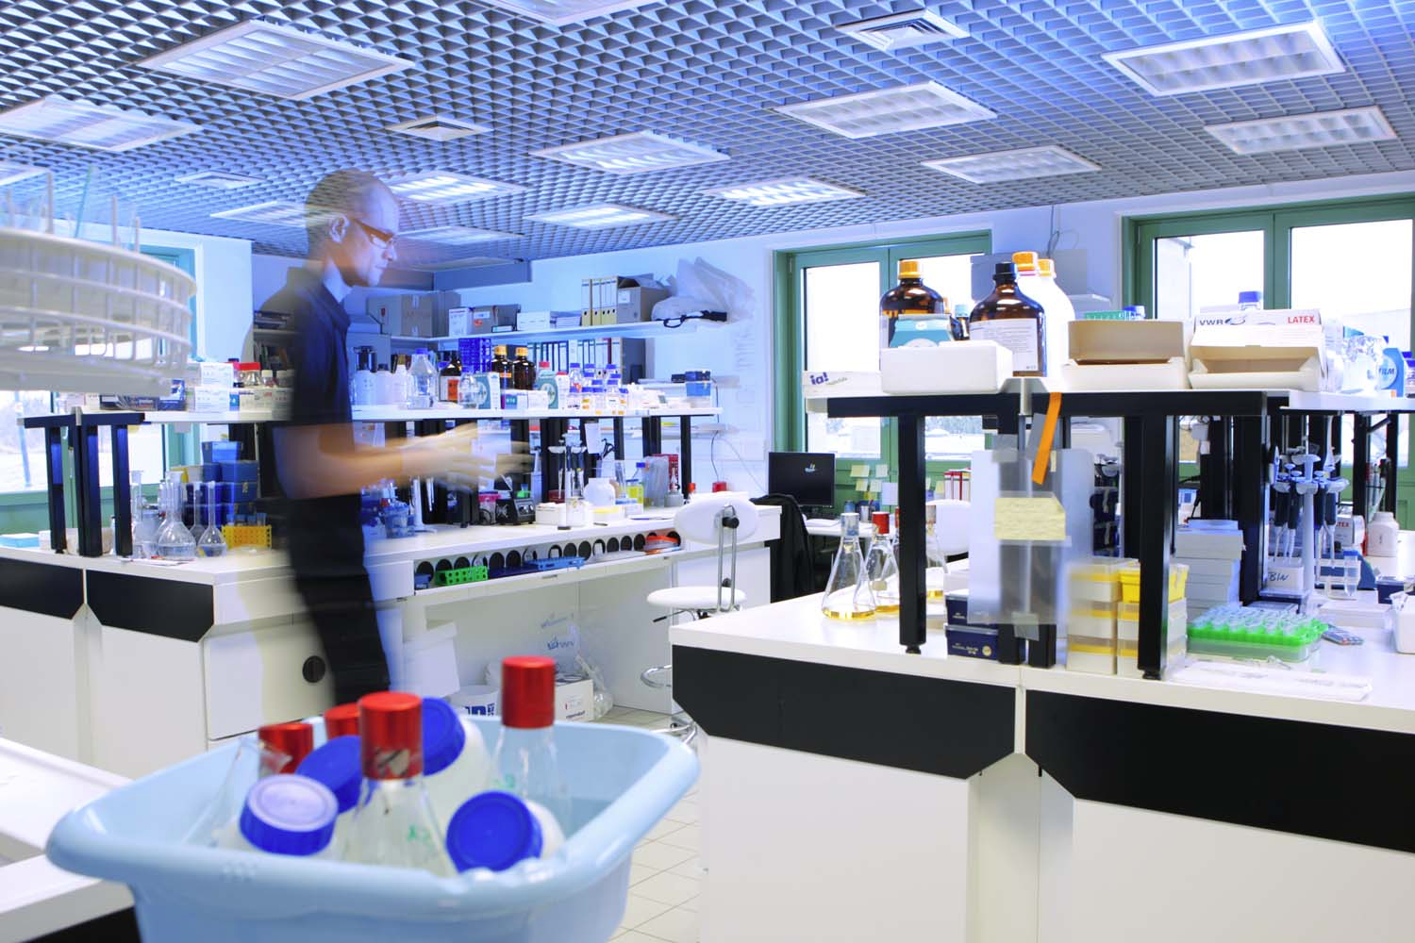
Biological Validation
Notes:
Our application: whether novel miR are real, whether differential expression is real, whether targets are real…etc…

Slide 17
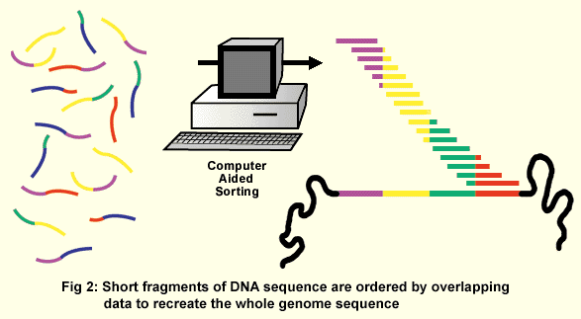
Application 2 - WGS
Notes:
Go quickly over the time and space issue when dealing with WGS. Just starting work, but our first-pass pipeline is in Python.

Slide 18
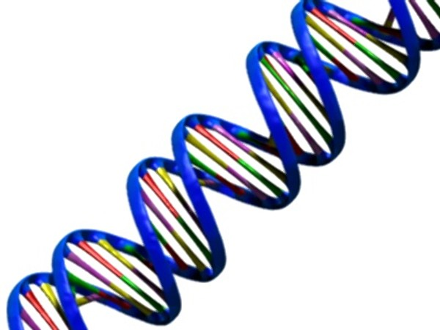
WGS
Task | Tool | Time (Hr) | Space (GB)
Extract | SamToFastq |  | 223
Align | bwa mem | 11:12:49 | 536
Softclip | CleanSam | 3:40:41
Convert | samtools view | 1:46:15 | 158
Sort | samtools sort | 6:45:08 | 155
Read Groups | AddOrReplaceReadGroups | 7:45:53 | 157
PCR Duplicates | MarkDuplicates | 8:35:56 | 154
Indels | RealignerTargetCreator | 5:20:04
Locally Realign | IndelRealigner | 10:29:25
Recalibrate 1 | BaseRecalibrator | 24:00:00
Recalibrate 2 | BaseRecalibrator | 17:18:39
Print Recalibration | Print Reads | 24:57:15 | 154
Call variants | UnifiedGenotyper | 22:57:12
Filter variants | VariantFiltering | 0:24:02
Annotate variants | snpEff.jar | 0:47:28
Total |  | 6 days, 2:00:47 hours | 1537

Slide 19
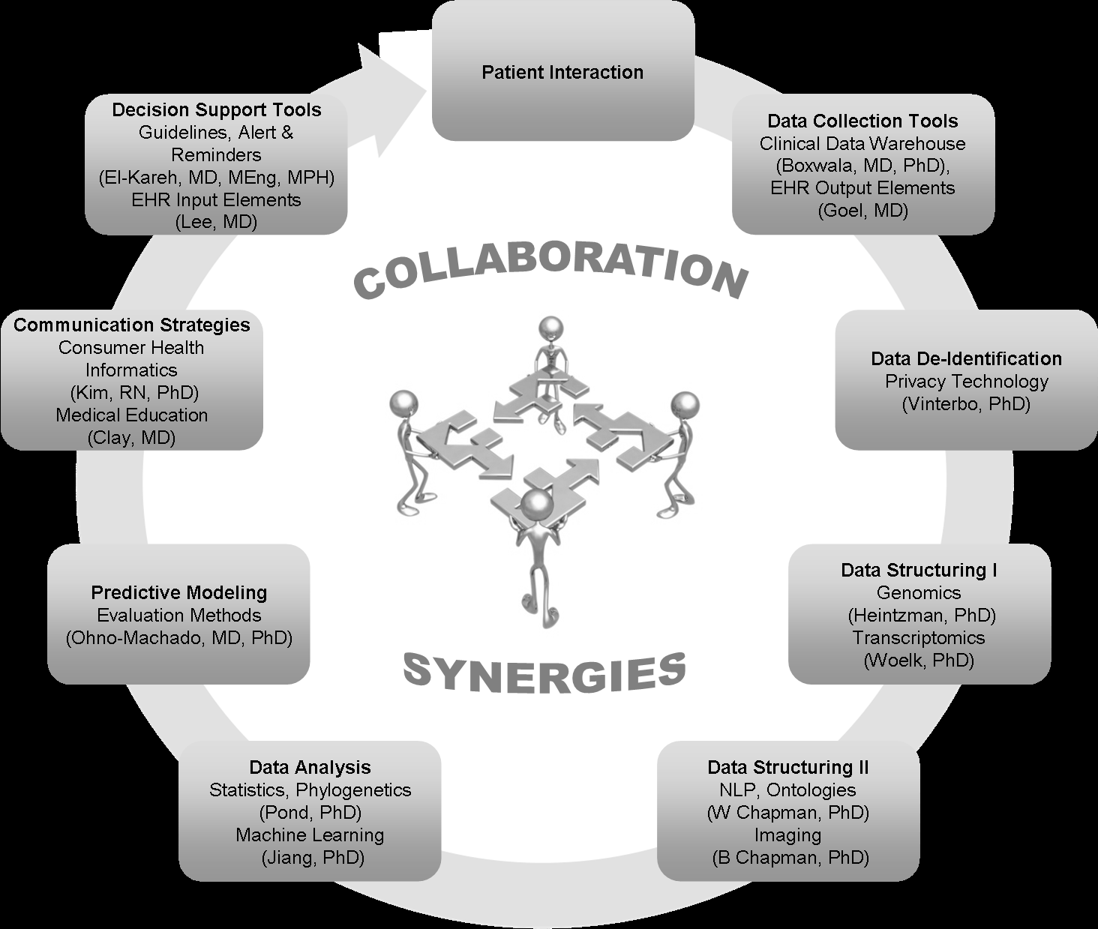
Opportunities in DBMI

Slide 20
iDASH
Notes:
Check out publications, information on projects, previous webinars.

Slide 21

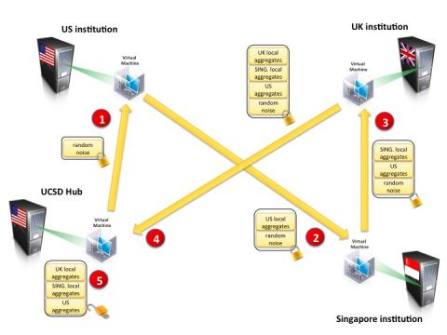
Biological Projects
Past:
Molecular phenotyping of Kawasaki Disease
Post-marketing medication surveillance
Individualized physical activity monitoring
Current:
Privacy preserving analytics for KD
Informed consent and trust
Privacy
Privacy-preserving machine learning
Differentially-private queries
Infrastructure
Cloud

Slide 22
DBMI
Weekly seminar
MED 262
Principles of Biomedical Informatics course
MED 264
Notes:
Promote study abroad and internship opportunities related to your research

Slide 23
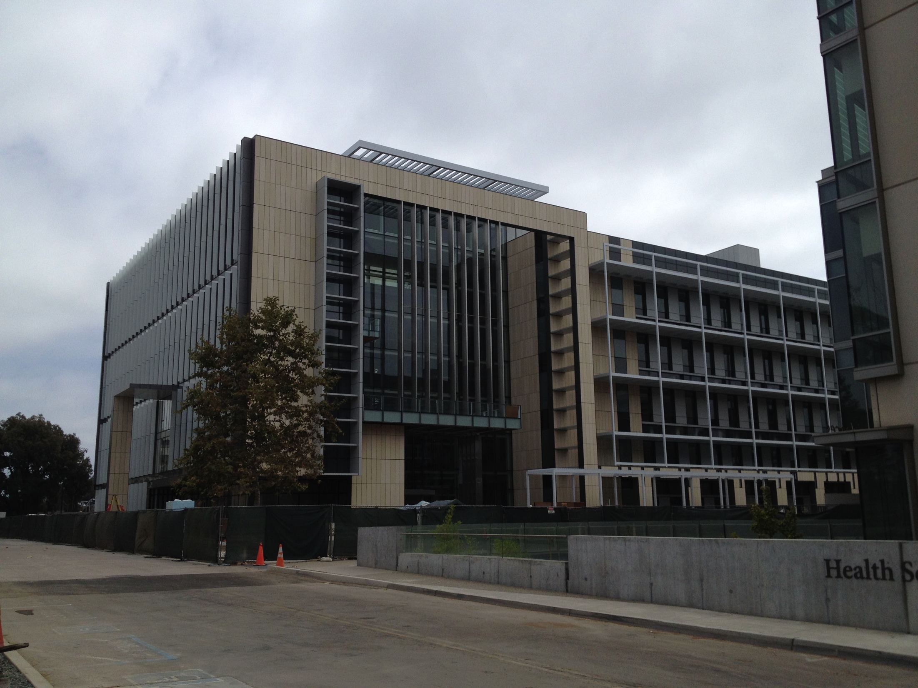
Thank you!
Questions?
E-mail me:
edlevy@ucsd.edu

